Slide 1





Westies
Citi HackOverFlow 2023
Kang Jun Hui Bryan
Mandfred Leow Hong Jie
Jazlyn Phua Jie Ling
Tan Jing Han
Jeff Tan

Slide 2





OUR TEAM
We are Westies, a team of passionate and forward-thinking individuals who are on a mission to shape the future of technology through innovation, creativity, and a relentless pursuit of excellence.
Jazlyn
Bryan
Han
Mandfred
Jeff

Slide 3
TABLE OF CONTENTS
Introduction
Problem Statement
Target User Group
Solution
Key Features
Demonstration
Technical Overview
Benefits
Future Enhancement
Conclusion
Q & A
Appendix

Slide 4

INTRODUCTION
The problem statement:
There is a need to centralize and streamline knowledge management within the banking sector to enhance productivity and decision-making.

Slide 5

PROBLEM STATEMENT
Scattered Data
Inefficiencies in Information Retrieval
Lack of Cohesion
Need for Instant Answers
Notes:
- Scattered Data: Banking operations generate an extensive volume of data, including customer information, transaction records, compliance documents, and market data. However, this data is often scattered across various systems, databases, and documents, making it challenging to locate and consolidate.
- Inefficiencies in Information Retrieval: The scattered nature of data hampers information retrieval and knowledge sharing. Employees spend significant time searching for relevant information, leading to inefficiencies and decreased productivity.
- Lack of Cohesion: Inconsistent organizational methods and varying levels of detail in documentation and data storage create confusion and hinder the ability to understand and integrate information effectively.
- Real-time Decision-Making: Banking decisions often need to be made in real-time, whether it's approving a loan application, detecting fraudulent activity, or executing trades. Instant access to relevant data and knowledge is vital for these decisions.

Slide 6






TARGET USER GROUP
General Citibank Customer
Millenials and Gen Z
Citibank Staff
Notes:
General Citibank users
Potential citibank users
Citibank staff

Slide 7








SOLUTION
TECHSTACK
AI Chatbot
REACT
NEXT.JS
TYPESCRIPT
TAILWIND
Frontend
A full-stack chatbot that leverages OPENAI Language Model (LLM) as the core technology behind its natural language understanding and generation capabilities.
Frontend/Backend
Frontend
Frontend
LANGCHAIN
Python Lib
PINECONE
Database
OPENAI
API(LLM)
Notes:
- Pinecone :
A Vector Database for Vector Search.
It has been specifically designed to store, index, and retrieve high-dimensional vectors. Which is ideal for machine learning applications like text and image classification, recommendation systems, and anomaly detection.
- LangChain:
LangChain is a framework for connecting large language models (LLMs) to other sources of data. It helps developers build applications that use LLMs to perform tasks such as document analysis and summarization, chatbots, and code analysis

Slide 8
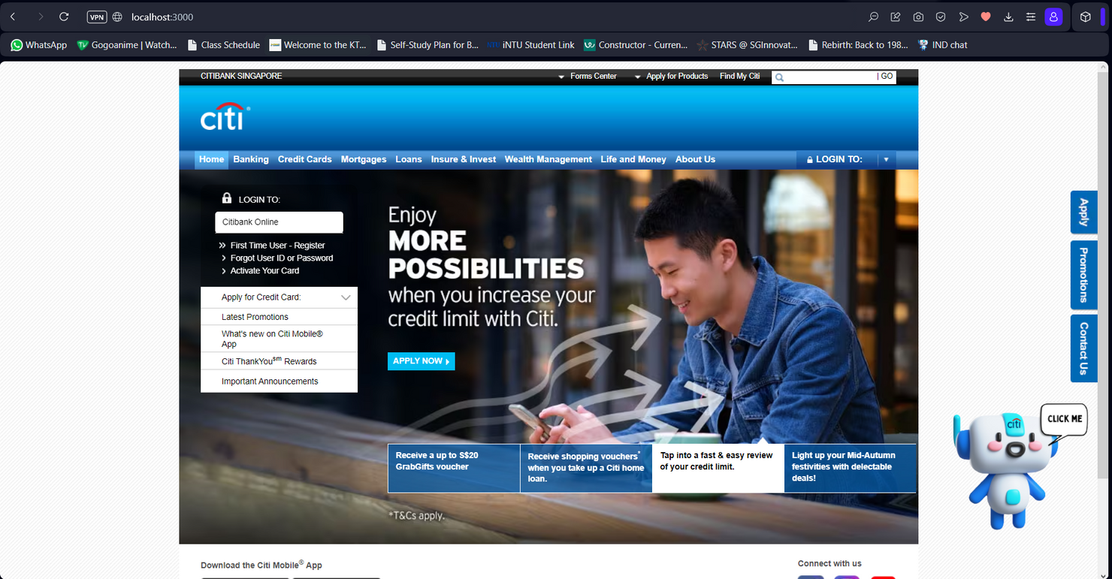
KEY FEATURES
CITIBOT CHARLIE
Your friendly website
assistant

Slide 9
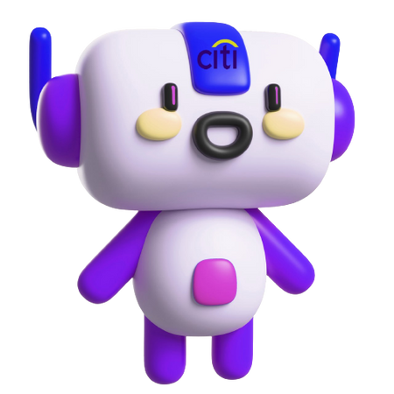
KEY FEATURES
Serves as a one-stop chatbot for citibank internal usage
Trained with customized data of your choice
MR CHARLIE
Internal Citibank
staff assistant

Slide 10

LIVE
DEMONSTRATION

Slide 11
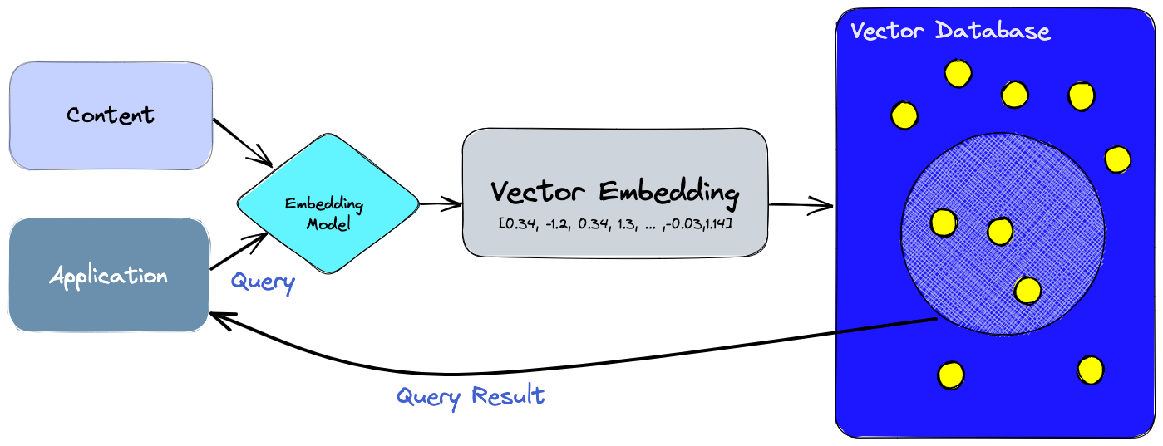

TECHNICAL OVERVIEW
Pinecone API
Figure 1. Vector Database. Retrieved from https://www.pinecone.io/learn/vector-database/
Notes:
A specialized database designed for efficient handling of vector embeddings, crucial for AI applications like language models and semantic search. It optimizes storage and querying for these embeddings,

Slide 12
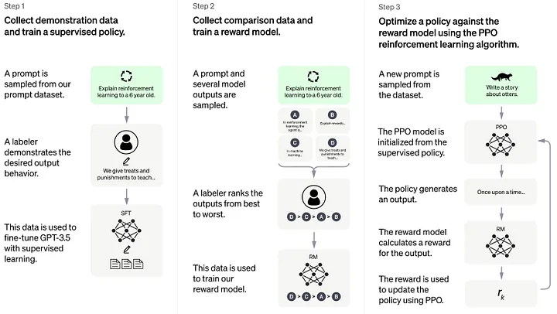
TECHNICAL OVERVIEW
OpenAI (LLM)
3.5 turbo
Figure 3. Reinforcement Learning. Retrieved from https://medium.com/@amol-wagh/open-ai-understand-foundational-concepts-of-chatgpt-and-cool-stuff-you-can-explore-a7a77baf0ee3
Notes:
It is based on the transformer architecture, which has revolutionized the field of NLP (natural language processing).
This model has been trained on a massive amount of data, allowing it to generate text and respond to various prompts with human-like precision and accuracy.

Slide 13
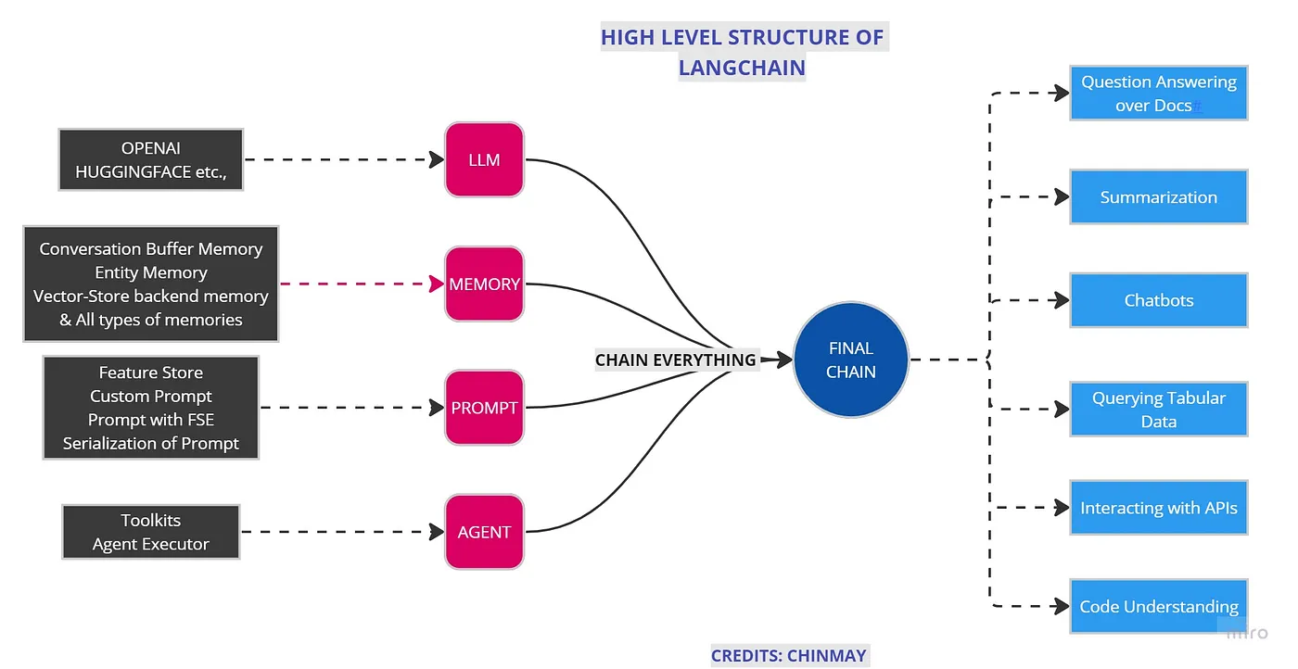
TECHNICAL OVERVIEW
LangChain
Figure 2. High Level Structure of LangChain. Retrieved from https://pub.towardsai.net/understanding-langchain-%EF%B8%8F-part-1-98499559f4c4
Notes:
LangChain is a framework for developing applications powered by language models
It does this by chaining different modules together.
The idea here is to chain every module in one chain and, at last, use that chain to call all modules at once.

Slide 14

BENEFITS
Efficiency
Accuracy
Scalability
Cost-effective
Notes:
- Efficiency: Faster information retrieval, reducing the time employees spend searching for data.
- Accuracy: Provides consistent and accurate information, reducing errors.
- Scalability: Can be expanded to cover more topics or integrate with other systems.
- Cost-effective: Reduces the need for extensive training or manual searches.

Slide 15

INTEGRATION WITH OTHER SYSTEMS
FUTURE ENCHANCEMENT
Core Banking System
Payment and Transfer Services
NLU IMPROVEMENT
Enhance the chatbot's ability to understand context and nuances in user input.
MULTILINGUAL SUPPORT
Expanding the chatbot to support multiple languages.
MULTIMODAL INTERACTION
An LLM Chatbot is a chatbot that leverages a Language Model (LLM) as the core technology behind its natural language understanding and generation capabilities. Language models, such as GPT-3
Enable voice recognition input and response capabilities to allow multitasking or help those with accessibility needs
Notes:
- Core Banking System:
Allows the chatbot to access account information, transaction history, and perform banking operations on behalf of users
- Payment and Transfer Services: Enables users to initiate payments, transfers, and bill payments using natural language commands through the chatbot
- Natural Language Understanding (NLU) Improvement:
Improve its ability to handle slang, regional dialects, and multi-language conversations.
- Multimodal Interaction:
Add support for both text and speech input/output.

Slide 16
CONCLUSION
Considering the target market, we derive an attractive solution that is efficient, accurate, scalable, and cost-effective.
Solution is easily integrable to Citibank’s main page where there is high website traffic.
Solution is abstract to be used in most knowledge-management problem

Slide 17
Jazlyn
Y4 NTU IEM
Bryan
Y3 NTU CS
QnA
Han
Y3 NTU CS
Mandfred
Y3 NTU CS
Jeff
Y3 NTU CS

Slide 18
THANK YOU

Slide 19
APPENDIX A : TECH

Slide 20
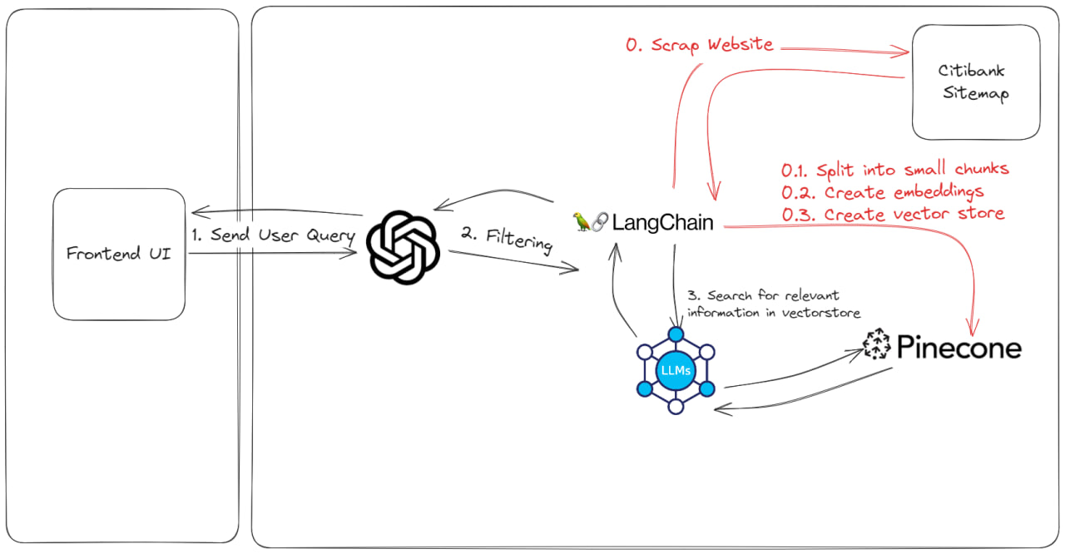
HOW THE FEATURES WORK?

Slide 21
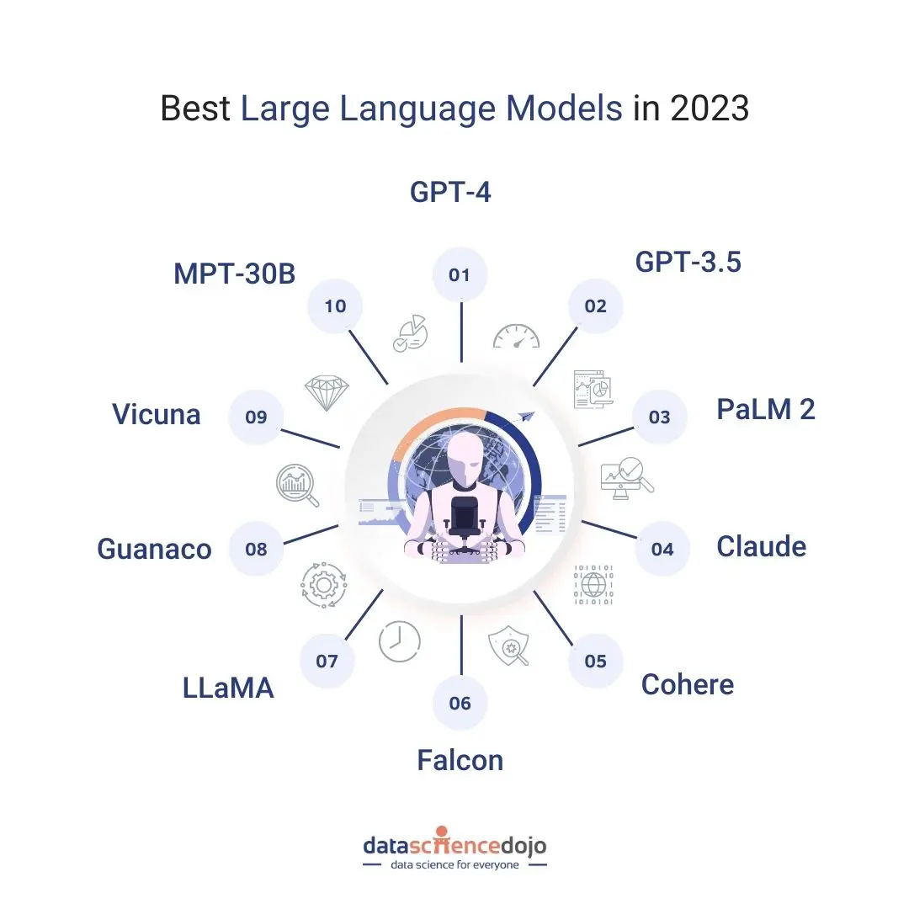
OTHER TYPES OF LLM MODEL
Notes:
1 trillion parameters

Slide 22
BENEFITS OF VECTOR STORE?
Semantic Representation: Vectors can capture the semantic meaning of data. For instance, word embeddings can capture the semantic meaning of words or sentences, and image embeddings can capture the content of images. This allows for more meaningful comparisons and operations on the data.
Efficient Similarity Searches: Vector spaces allow for efficient similarity searches, such as finding the most similar items to a given item. This is particularly useful in recommendation systems, image retrieval, and other applications where you want to find items similar to a given query.
Compression: In some cases, representing data as vectors can lead to compression, especially when the original data is large and the vector representation is of a lower dimension.

Slide 23
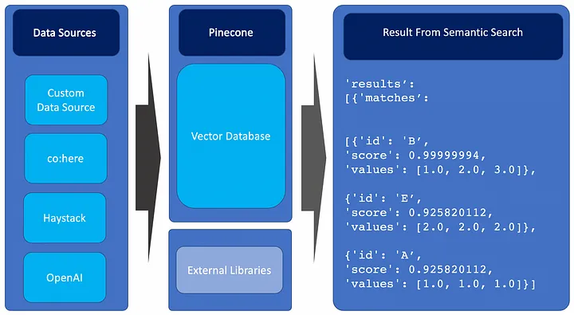
WHY PINECONE?
Pinecone can swiftly look for related data points in a database by displaying data as vectors so that it may be searched. This makes it ideal for a range of use cases, including semantic search, similarity search for images and audio, recommendation systems, record matching, anomaly detection, and more
Figure 4. Pinecone process. Retrieved from https://medium.com/@amol-wagh/open-ai-understand-foundational-concepts-of-chatgpt-and-cool-stuff-you-can-explore-a7a77baf0ee3
Notes:
Pinecone is optimized for similarity search, enabling you to efficiently find data points that are similar to a query vector. This is especially useful for recommendation systems, where you want to find items or content similar to what a user has previously interacted with.
Pinecone is designed to scale horizontally, making it suitable for handling large datasets and high query volumes. This scalability is crucial for applications that require real-time or near-real-time responses.
Pinecone provides APIs and SDKs that are easy to integrate into your applications. You can send vectors to Pinecone for indexing and querying via straightforward API calls, which simplifies the development process.

Slide 24
APPENDIX B : BUSINESS

Slide 25
COST ANALYSIS
OPEN AI | Model | Input | Output
OPEN AI | Model | Usage | Usage
GPT-3.5 Turbo | 4K context | $0.0015 / 1K tokens | $0.002 / 1K tokens
GPT-3.5 Turbo | 16K context | $0.003 / 1K tokens | $0.004 / 1K tokens
Embeddings models | Ada v2 | $0.0001 / 1K tokens | $0.0001 / 1K tokens
You can think of tokens as pieces of words, where 1,000 tokens is about 750 words. This paragraph is 35 tokens.

Slide 26
COST ANALYSIS(CONT)
E.g.
1 hour = 750 words
(Inclusive of Input and Output)
24 hours = 18,000 words
(Split them into Input and Output)
OPEN AI | Model | Input | Output | Total
OPEN AI | Model | Usage | Usage | Total
GPT-3.5 Turbo | 4K context | $0.0015 * 9 = $0.0135 | $0.002 * 9 = $0.018 | $0.0315
GPT-3.5 Turbo | 4K context | $0.0015 * 9 = $0.0135 | $0.002 * 9 = $0.018 | $0.0315
Embeddings models | Ada v2 | $0.0001 * 18 = $0.0018 | $0.0001 * 18 = $0.0018 | $0.0018
 |  |  | Subtotal | $0.0333
Monthly Cost | Monthly Cost | 30 x $0.0333 | 30 x $0.0333 | $0.999
You can think of tokens as pieces of words, where 1,000 tokens is about 750 words. This paragraph is 35 tokens.

Slide 27
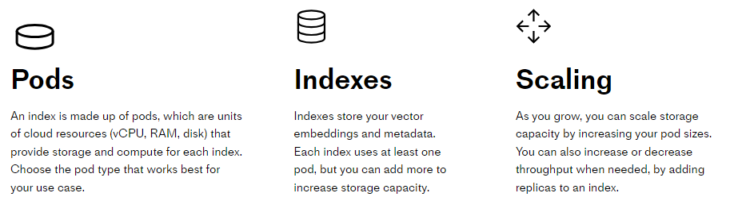
COST ANALYSIS ( PINECONE )
PLANS | PLANS
Standard | Enterprise
starting at $70/month | starting at $104/month
For production applications at any scale. | For mission-critical production applications.
Standard Support | Premium Support
Notes:
Standard:
Estimated for one index on one s1 pod running for 30 days at $0.096/hour
Enterprise:
Estimated for one index on one s1 pod running for 30 days at $0.144/hour
Premium Support:
24/7/365 dedicated support
Up to 4 technical contacts

Slide 28
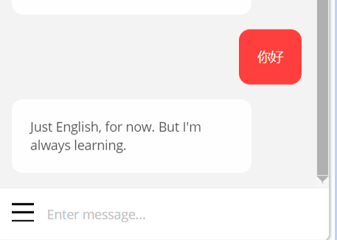
COMPETITOR ANALYSIS
Some chatbot on some website

Slide 29
APPENDIX C : DATA

Slide 30

HOW DID WE GET THE DATA? (CITIBOT CHARLIE)
We have a tool that fetches website data for us.
Think of it like a robot that visits a website, looks at its map (sitemap), and then collects information from all the pages listed on that map.
This robot can collect data from multiple pages at once, but it's polite and doesn't overwhelm the website. It collects data from 2 pages every second.
Setting Up the Environment
Once we have the data, it's often too big to work with. So, we break it down into smaller, manageable pieces.
Imagine having a long book and dividing it into chapters.
Understanding the Data
Next, we use a tool to understand and represent our data in a way that machines can easily process.
This is called creating "embeddings".
Think of it as translating a language you don't understand into one you do.
Storing and Searching the Data
Now, we need a place to store this translated data and a way to search through it quickly.
We use a tool called Pinecone to do this. It's like a library where each piece of data is a book. We can quickly find the book we want based on its content.
If we're using Pinecone for the first time, we create a new shelf (index). If we've used it before, we just add our new books to the existing shelf.
Notes:
We have a tool that fetches website data for us.
Think of it like a robot that visits a website, looks at its map (sitemap), and then collects information from all the pages listed on that map.
This robot can collect data from multiple pages at once, but it's polite and doesn't overwhelm the website. It collects data from 2 pages every second.
Setting Up the Environment
There's a small glitch when using our tool with a specific platform called Jupyter. We've fixed that glitch with a piece of code.
We then tell our robot which website map to look at and which pages to focus on.
Breaking Down the Data
Once we have the data, it's often too big to work with. So, we break it down into smaller, manageable pieces.
Imagine having a long book and dividing it into chapters.
Understanding the Data
Next, we use a tool to understand and represent our data in a way that machines can easily process. This is called creating "embeddings".
Think of it as translating a language you don't understand into one you do.
Storing and Searching the Data
Now, we need a place to store this translated data and a way to search through it quickly.
We use a tool called Pinecone to do this. It's like a library where each piece of data is a book. We can quickly find the book we want based on its content.
If we're using Pinecone for the first time, we create a new shelf (index). If we've used it before, we just add our new books to the existing shelf.

Slide 31
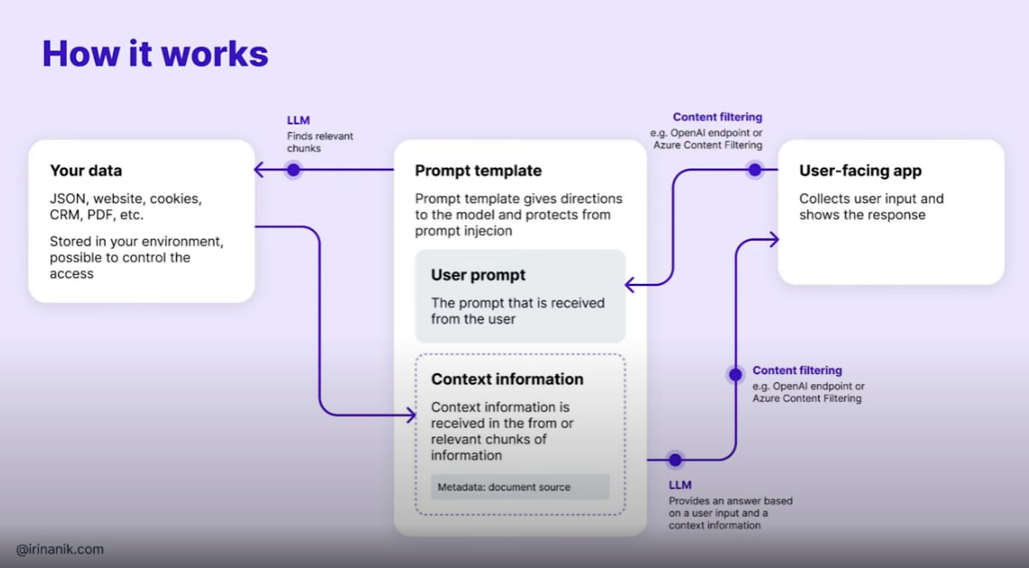
HOW IS DATA TRAINED?

Slide 32
TYPE OF DATA COLLECTED
Json Format for the vector
Data can be of any nature
text,images,audio,video,Tabular Data

